Slide 1
Pyramid
Step toward the smart Business!
By: Vaibhav Dagade
Contact : vaibhav.Dagade@gmail.com
Mobile : 9850565304

Slide 2
On Demand Software
Application suite to manage all program activity
Professional
Services
Optimize program design and performance
Program
Management
Streamline operations with administrative services and support

Slide 3
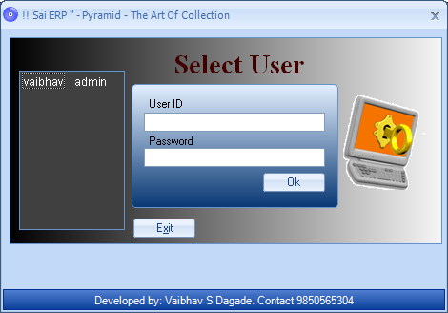

Slide 4

Pyramid
It takes more than just hardware
to solve problems and provide efficiency
in a challenging business environment

Slide 5
Features
Stock Management
Runtime Barcode Creation
Barcode Printing
Advance Search
Easy to Track the Record
Traditional service bureaus
Customer Record
Bill Printing
This ensuring optimum productivity for operators

Slide 6


The Pyramid
Barcode Management
Easy to Use
Runtime Barcode Creation
Support Barcode Printing
Search Product using Barcode Scanner
Can Operate at Operator Level
Stickers with Barcode
History report

Slide 7
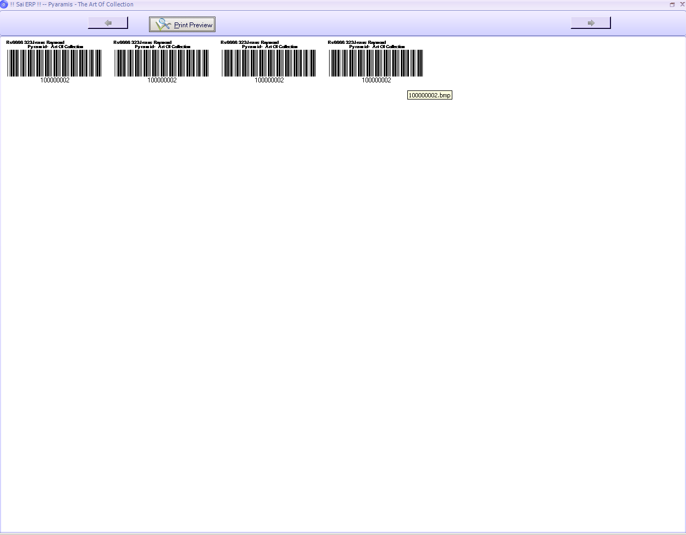

Slide 8
The Pyramid
Stock Management
Easy to Use
Runtime Barcode Creation
Track the Payment Mode record
Maintain Vendor record with respective stock
Support User Privilege for security

Slide 9
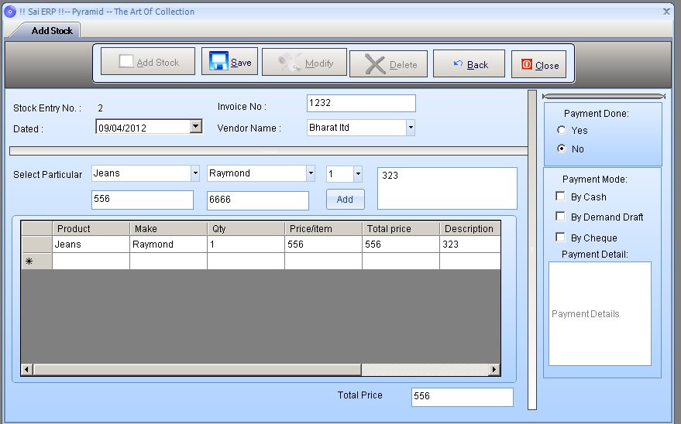

Slide 10
The Pyramid
Theme Customization
Easy to use
Customized theme for software
All Menu & submenu colour combination can change
Wallpaper can be set & stored

Slide 11


Slide 12
The Pyramid
Report
Easy to use
Report can be generated at any time
Search Base report helps user to faster Report generation
Report Format – PDF
Support User Privilege
Operator level tracking
Sell percentage at the end of the day

Slide 13
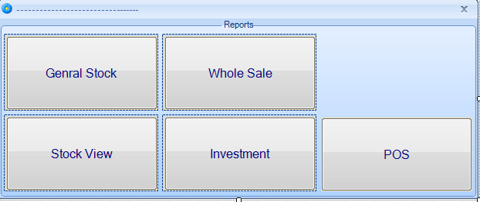

Slide 14
Thank You!

